Slide 1
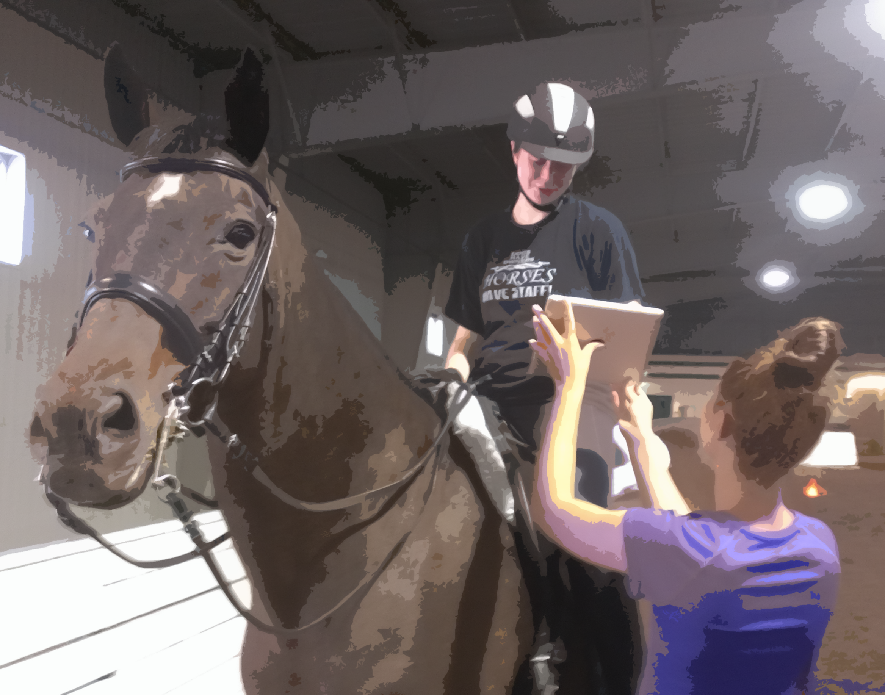
Digital video in the riding arena
Video as a instructional scaffolding tool
By Karen Pautz, EDU 500, Summer Term 1, 2013
Click, use arrow keys or space bar to proceed

Slide 2
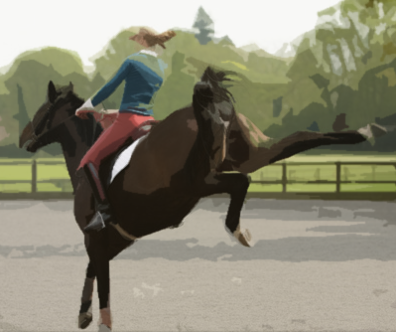
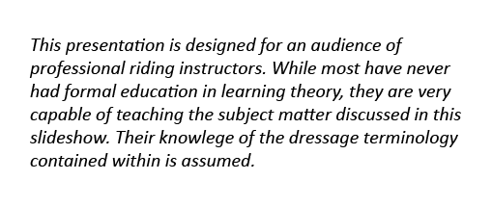
We’ve all been there – a riding lesson customer is in the ring, and things aren’t going exactly as planned.
You want to give her explicit instructions, but you can’t – by the time you can utter coherent recommendations, it’s too late.
At that moment, you curse yourself for allowing your student to become so reliant on you.

Slide 3
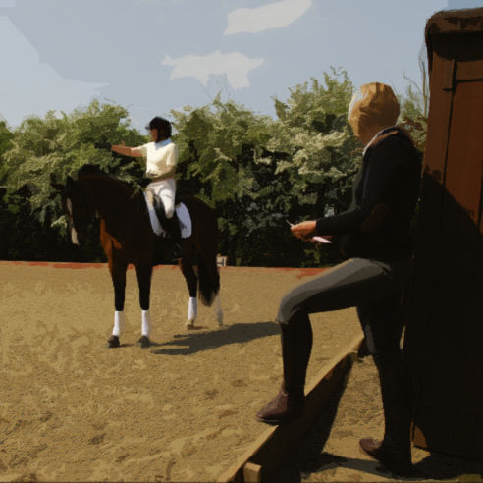
As a caring instructor, you work hard to make your students self-reliant.
After all, you won’t always be there
to help them.
They ride their horses when you’re not at the barn.
And when they’re in the competition arena, calling out to a rider will result in her elimination. That’s not good!

Slide 4
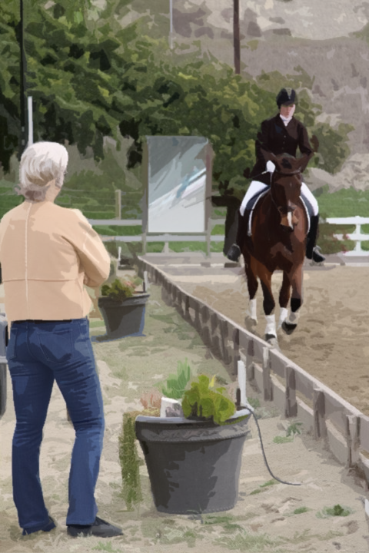
But how do you do it?
How do you go from being the constant bug in the rider’s ear, to a mentor who guides but doesn’t dictate?
Simple!* It’s a teaching technique called SCAFFOLDING.
*And by simple, I mean “really, really hard.” But it’s do-able.
And worth it. We’ll discuss some pros and cons in a little
while.

Slide 5
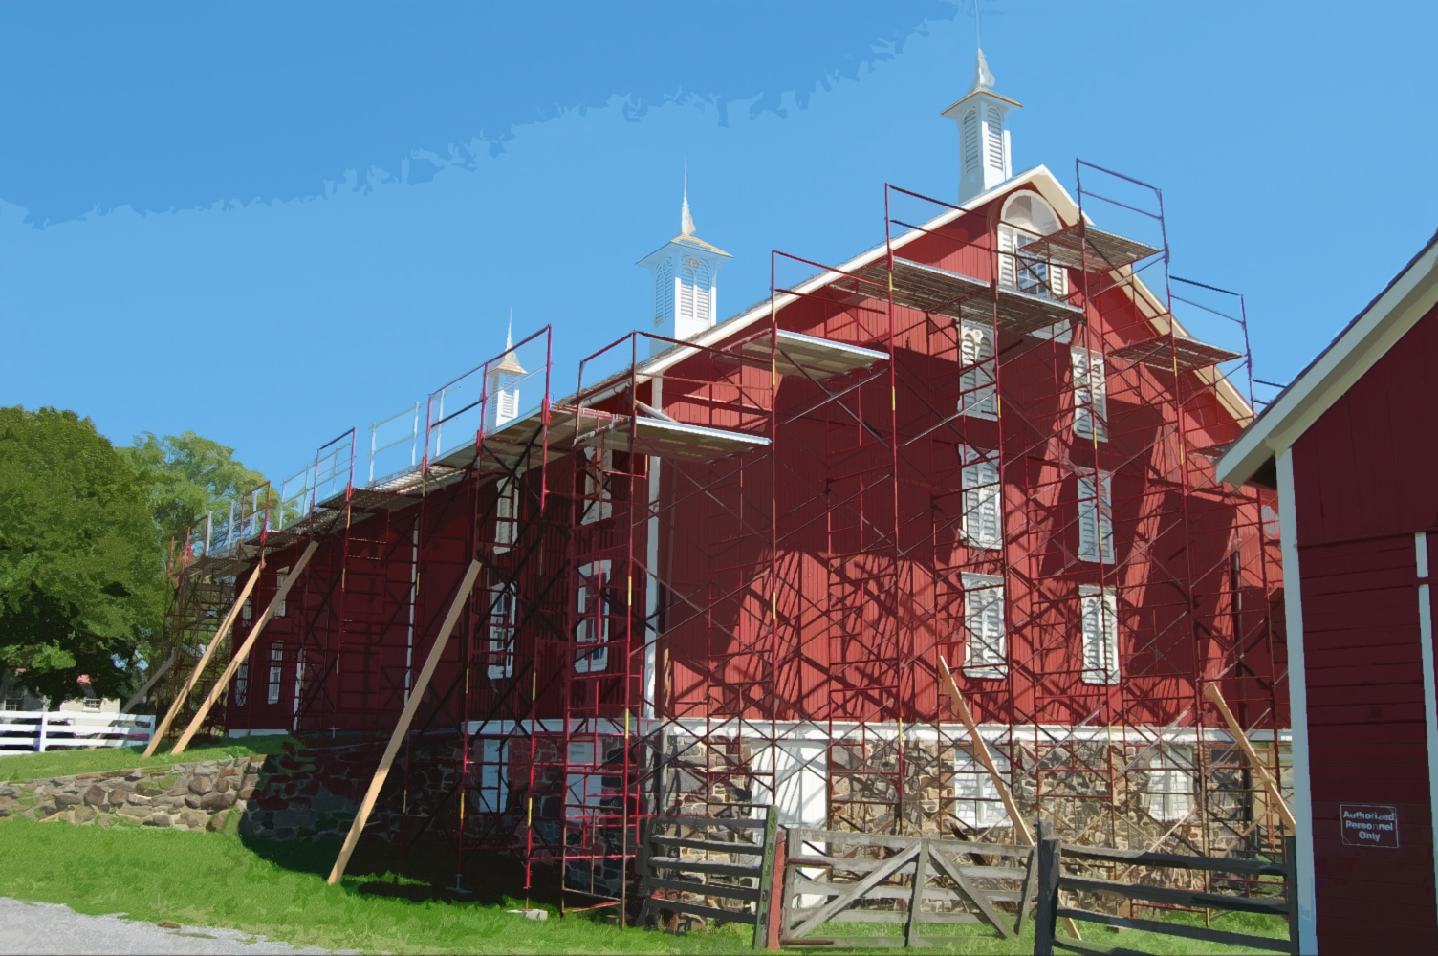

Scaffolding is a metaphor for the support an instructor gives a student until she’s ready to stand on her own.
Scaffolding is concerned with the teaching of tasks or concepts just beyond the student’s current ability to grasp on her own.
As the student gains mastery, the support is removed, allowing the student to work independently.
_{Citation}

Slide 6
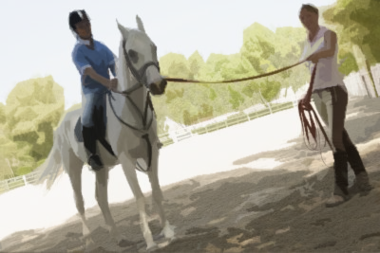
See? Now you feel better!
You’ve been doing this all along, intuitively.
From the first moment you stepped away from your new rider’s side, unclipped the lunge line and allowed her to control the horse on her own, you’ve been using scaffolding. Whew!
But for a moment, let’s review. . . .

Slide 7

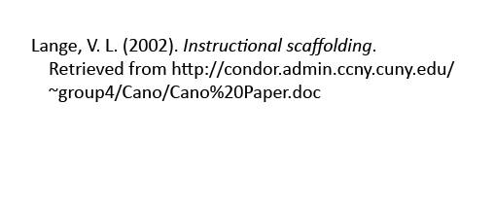
Scaffolding is an accepted method of teaching learners to become self-sufficient.
Successful scaffolding requires the instructor to assess a student’s current abilities, and carefully guide her in logical steps to new understandings.
As the student gains mastery, the instructor adds complexity until she is able to perform without support.
_{Citation}

Slide 8
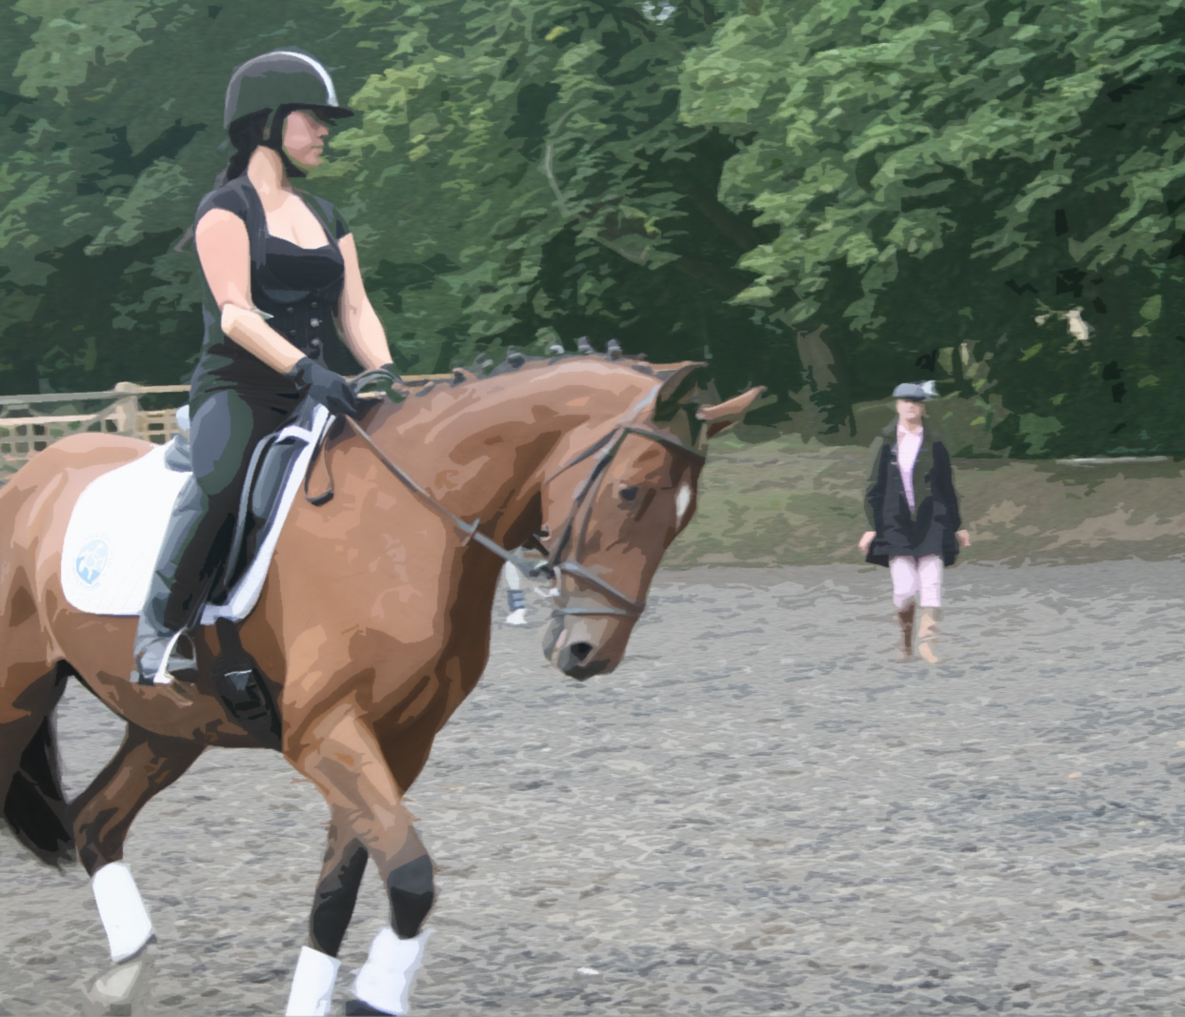

In general, scaffolding techniques can be distilled down to five basic steps:*
modeling the task
offering explanations
inviting student participation
clarifying and verifying student understandings
inviting students to take the lead
*You might recognize this as the standard riding instructor’s mantra of “explanation, demonstration, imitation, repetition.” See, I told you that you already did this!
_{Citation}

Slide 9
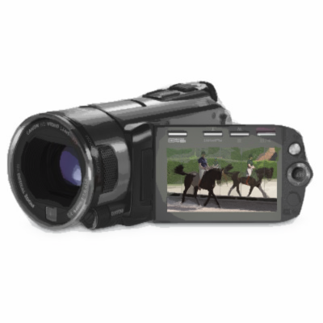
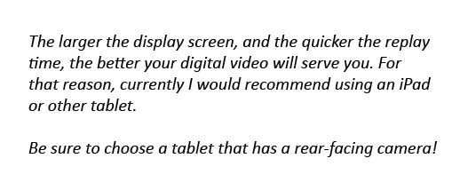
And now that you know you’re doing right by your students, let’s get to the point of this presentation:
Digital video
is a powerful tool for instructional scaffolding.
If you have a video camera with a display screen, a smartphone, or a tablet computer, you’re good to go!

Slide 10
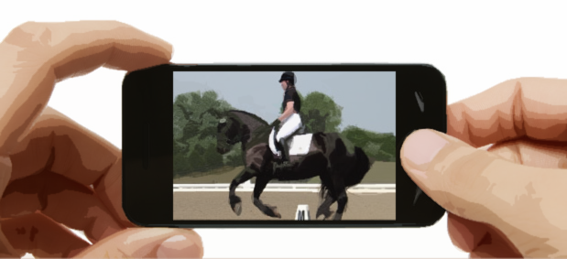
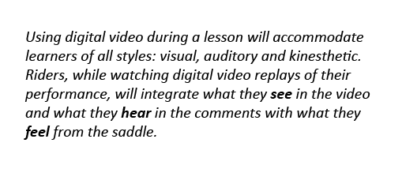
Why digital video?
It’s a visible re-affirmation of comments
It’s almost immediate (only mirrors are completely immediate)
It’s replayable (unlike mirrors, where the moment is there-and-gone)
It’s manipulable (you can replay in full speed or slow motion)
It’s diagnostic (comparison software and apps are readily available)
It’s storable (you can refer to older videos for comparison’s sake)

Slide 11
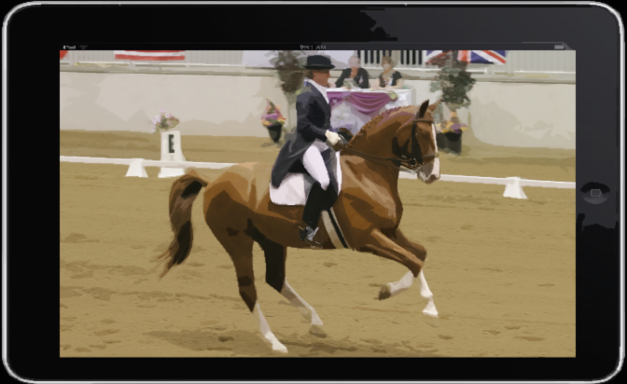
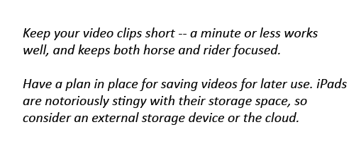
Qualities of a useful digital video device:
It must have a display screen easily visible from horseback
It must have sufficient internal storage
It must store videos in a useful format (.mpg, .mov., .avi)
And most importantly:
You must feel comfortable using it – you must be able to teach while observing the rider through the camera lens or device display

Slide 12
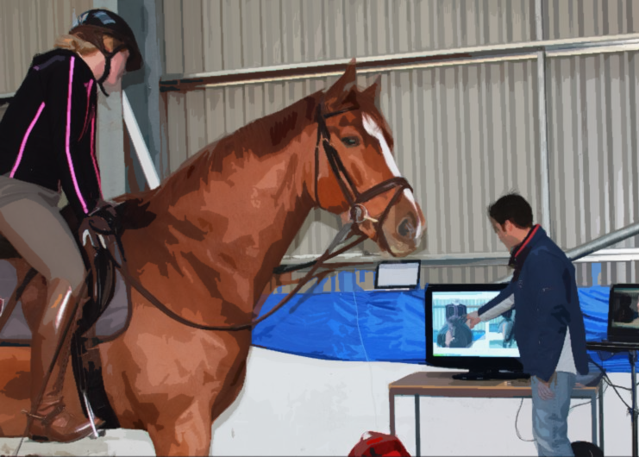
You can use digital video in all phases of instructional scaffolding.
Let’s review the phases:
modeling the task
offering explanations
inviting student participation
clarifying and verifying student understandings
inviting students to take the lead
Let’s explore, using a lesson on shoulder in as an example.
_{Citation}

Slide 13
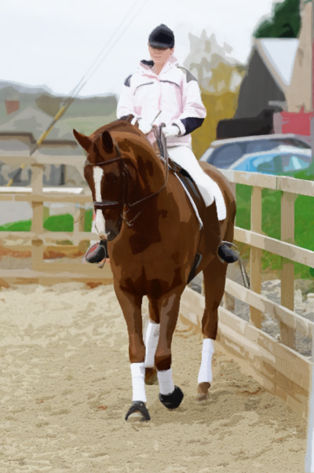

Phase 1: Modeling the task
Make sure your student understands the precursors to shoulder-in: bend, angle, track, inside/outside aids.
Once you have that, you could try to explain shoulder-in verbally.*
Or you can show static diagrams and photos.
Better yet. . . .
*How much time do you have?

Slide 14

Phase 1: Model the task
. . . show a video of a horse and rider demonstrating a correct shoulder in.
While your rider observes, discuss the movement’s requirements.
Talk to her about the application and timing of the aids.
Proceed to Part 2
Mouse anywhere in the video frame to enable controls

