Slide 1
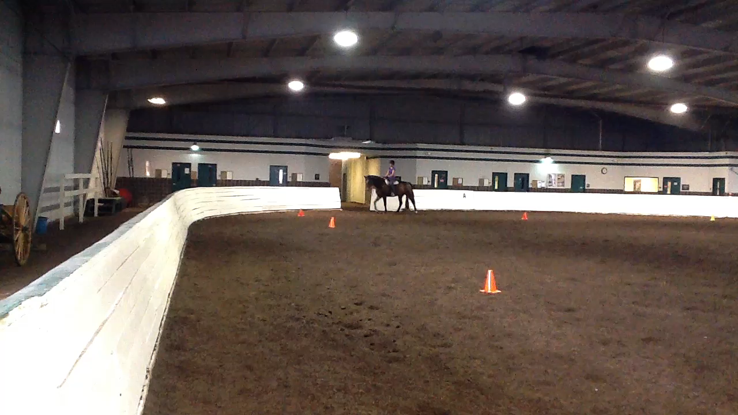
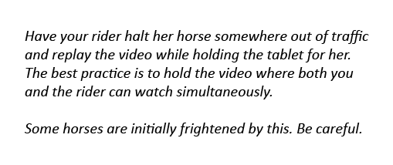
Phase 2: Offer explanations
This is the time during which you essentially “ride” the horse for the student, telling her how to use each aid to achieve the desired result.
After your student rides the shoulder in, call her over to watch her performance while she listens to your commentary on the video clip.

Slide 2
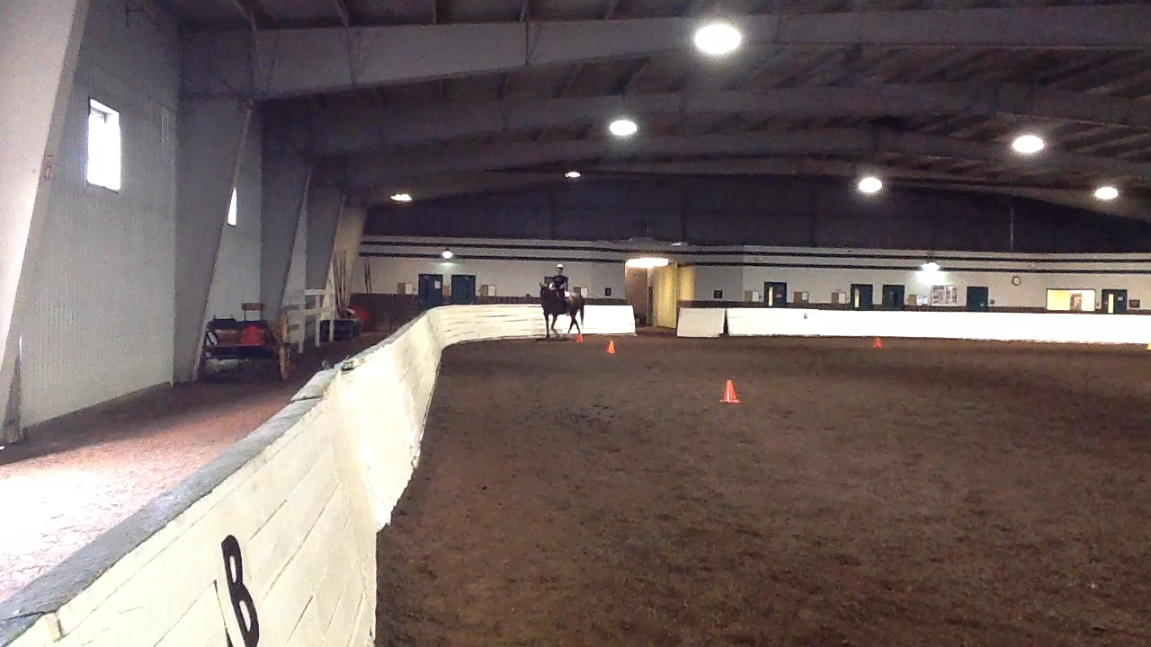
Phase 2: Offer explanations
A more advanced rider, who understands the concepts behind shoulder in, needs even less detailed explanation.
Point out the components of the movement that need correcting, but allow the rider to solve the problem on her own.
Finish the exercise by allowing her to watch her video to affirm her decisions.
Proceed to Part 3

