Slide 1
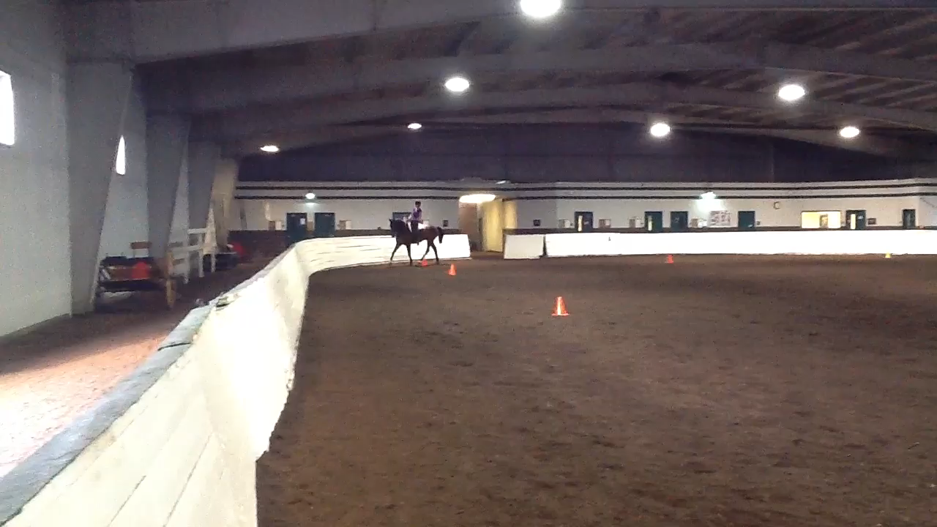
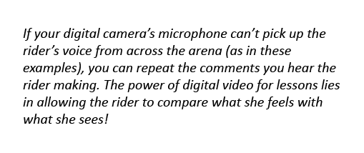
Phase 3: Invite student participation
Now it’s time to ask your student to make her own decisions.
Instead of telling, ask.
After she assesses her performance, allow her to watch her video clip to reinforce (or contradict) her decision.

Slide 2
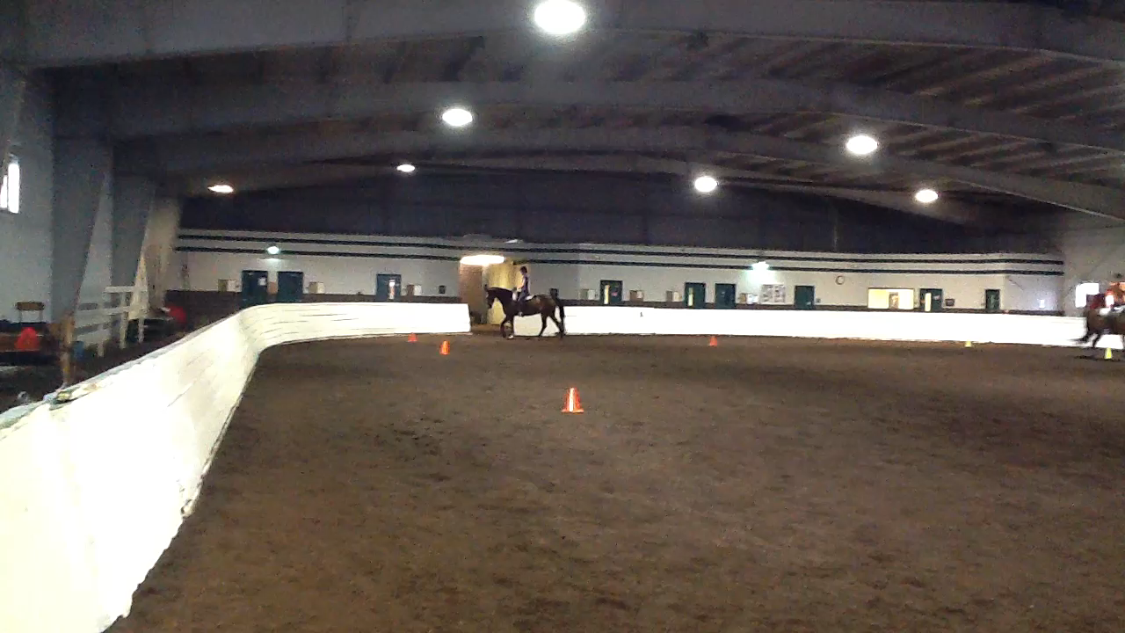
Phase 3: Invite student participation
Keep in mind that your student is new to this task, and there will be plenty of struggling, and the occasional mistake.
Be patient, and give her a chance to work out the answer before jumping in with the solution.
Proceed to Part 4

