Slide 1
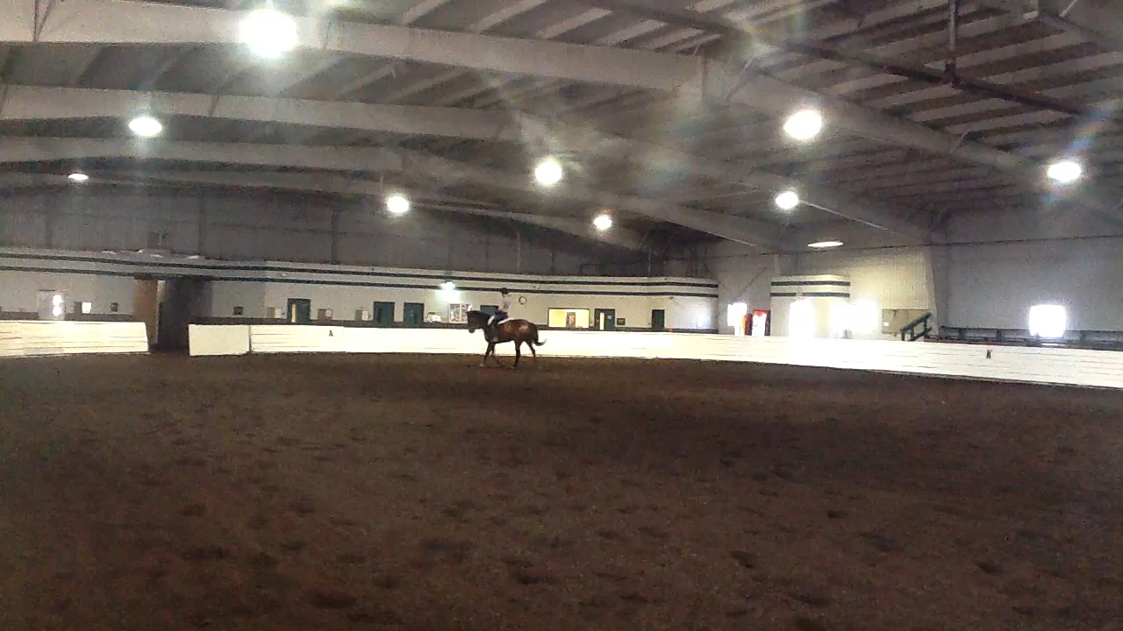
Phase 4: Clarify and verify
student understandings
Asking your student to assess her work will help you keep track of her progress.
It’s important at this point to keep your student focused on specifics: sometimes too much knowledge is a dangerous – or at least distracting – thing!

Slide 2
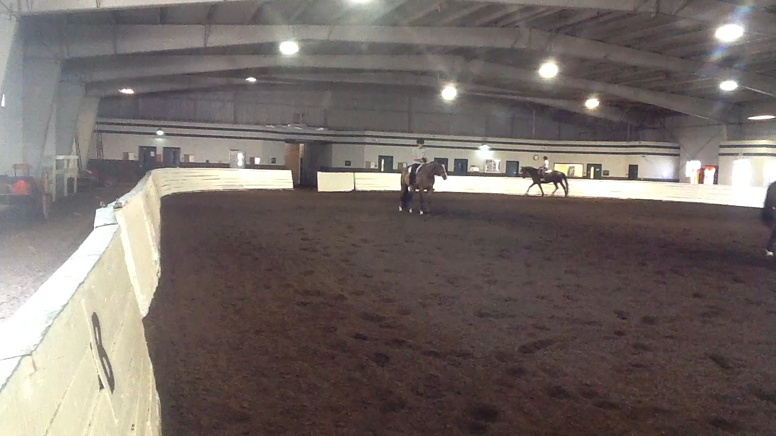
Phase 5: Invite students to take the lead
At this point, your student has mastered the task.
Your job – and that of the digital video – is simply to confirm the student’s assessment.
Once she learns to use video in this manner, she can ask anyone to run the camera for her.

Slide 3
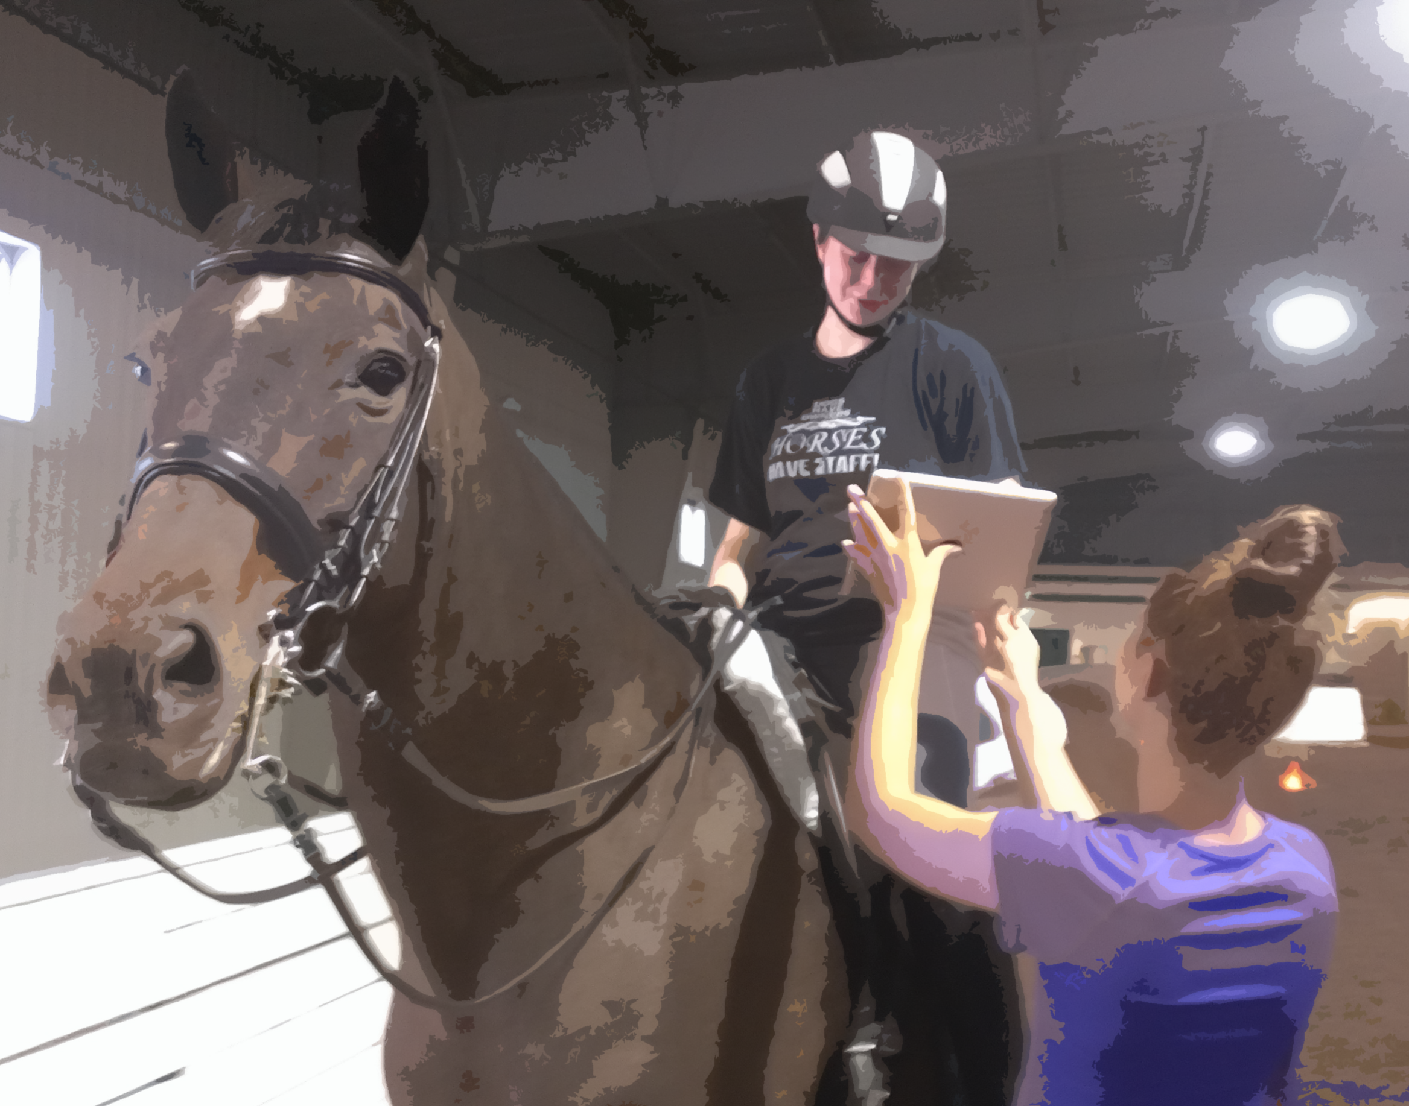
Congratulations!
You’ve helped your student gain the deep understanding needed to become self-sufficient.
Using the digital video as a tool in your instructional scaffolding enhances your actions. Remember, in riding instruction, a picture is truly worth a thousand words.

Slide 4
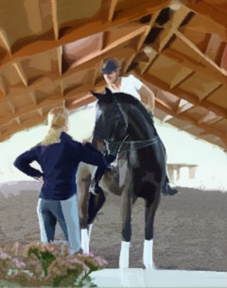
But what’s that you say? You’re worried that if you use this technique, your students won’t need you anymore?
Nonsense! There’s always more for a rider to learn, especially in dressage.
In addition, the confidence you’ll instill in your rider only solidifies your relationship.

Slide 5

Credits
Thanks to these William Woods students and horses, who ably demonstrated the learning process, warts and all.
Sarah-Rose Brush & Strider (Isildur’s Heir)
Lucy Fuelle & Rizzo (Raphaelo)
Krista Spencer & Take Over (Tigger)
Ashley Sundin & Wajombo (Wajombo)

Slide 6
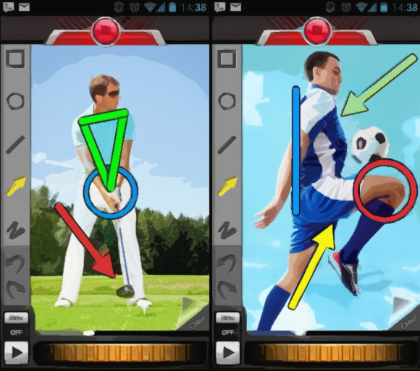
Video coaching apps
These apps allow for side-by-side analysis of two videos, with overlay diagrams
The Coaches’ Eye
Sports Video Analysis Software
http://www.coachseye.com/
Motion Pro Software
Motion analysis software for all sports
http://www.motionprosoftware.com/
Ubersense
Video Analysis and Sports Coaching App
Ubersense: Video Analysis & Sports Coaching App
Return to Part I

